Slide 1



Analyzing Nursing Home Investments
Big Apple
vs
Sunshine State

Slide 2


Retirees: The Silver Stakeholders
Retirees
Who:
Elder individuals > 62 years of age
Family members of these individuals
What are they looking for:
Safe, secure, and high quality
Better quality of life, entertainment, family
Typical retiree:
Elder individuals who need assistance in their day-to-day life
Stakeholders | Financial Performance| Operational Performance| Recommendation

Slide 3


Aging Gracefully, Investing Wisely
Investors
Who:
Geri Attrick, Investment Funds, Wealthy Individuals
Why:
Stable long-term investments
Lower risk but less liquidity
Typical Investment:
Cash investment into a business as they do not have a market to trade on
Stakeholders | Financial Performance| Operational Performance| Recommendation

Slide 4
Which Do You Prefer, City Lights or Ocean Sights?
New York
Florida
Public Transportation
City Culture
Walkable Cities
Entertainment
Age Friendly
Easy Travel
Better Weather
Active Lifestyle
Tax Benefits
Stakeholders | Financial Performance| Operational Performance| Recommendation

Slide 5
Stable and Sustainable Returns From Nursing Homes
Generate a reasonable return in a non-traditional asset class
Adds diversification to their portfolio to protect against market downsides
Investment Return
Human business, ethical issues lead to low performance in long run
Average nursing home stay is 28 months, 21% of residents stay over 5 years
Reduce volatility over the long term
Long term Sustainability
Stakeholders | Financial Performance | Operational Performance | Recommendation
Notes:
SAM B
Thank you, Iris. From an investment perspective, we consider two key aspects. The first aspect is return on investment as investors are seeking good returns and diversification. Nursing homes offer diversity from traditional investments and protect against housing or stock market downturns.
The second aspect is long-term sustainability as investing in nursing homes involves considering ethical and human issues. Retirees and the elderly make up this business, and with an average stay of 28 months and 21% of residents staying over 5 years, nursing homes give reduced long-term volatility. We highly recommend buying and holding these investments.

Slide 6
What Is the Objective?
Is the nursing home and elder care market a profitable investment?
Which is the better state to invest in between Florida and New York?
Cost Report
Quality Measure
Penalties
Provider Info
Health Deficiencies
COVID Vax
Stakeholders | Financial Performance | Operational Performance | Recommendation
Notes:
SAM B
For this phase, we have two main objectives. In the previous phase of this competition, we proved nursing homes as a viable investment compared to other investment standards. Now, we want to dig deeper and see which state is better to invest in between Florida and New York.
Also, for those unfamiliar with the dataset, it includes various sections, such as Cost Reports, Quality measures, penalty information, provider information, health deficiencies for individual nursing homes, and COVID-19 vaccine adoption data.
Cost Report, Quality Measure, Provider Info, Covid Vaccines, Health Deficiencies, Penalties
Cost Report for individual nursing home financial information
Quality measures for overall rating and other rating metrics
Provider info for information on individual nursing homes
Covid Vaccines for showing which states adopted vaccines faster and more widely
Health deficiencies for the results of inspections conducted by health inspectors
Penalties for showing penalty type and suspension length for nursing homes

Slide 7
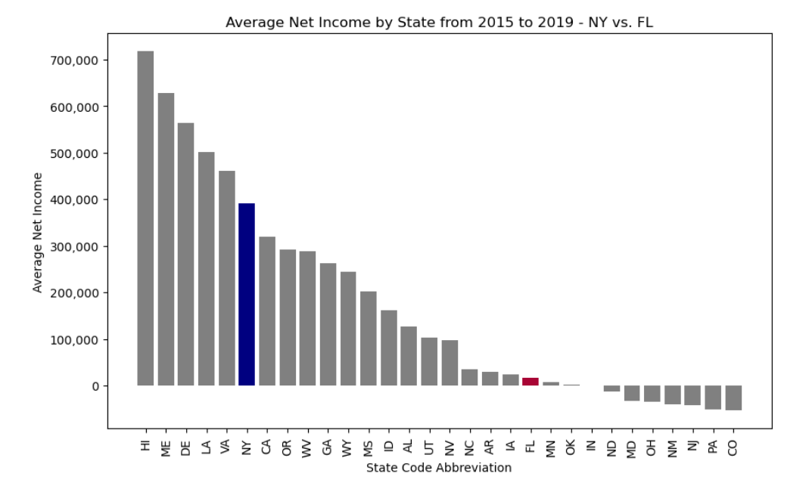
Net Income Is an Ineffective Metric
New York
Florida
Problems with Net Income
Inconsistent across different years
Does not look at assets or liabilities
Does not show investment returns
Stakeholders | Financial Performance | Operational Performance | Recommendation
Notes:
SAM B
As you can see from this graph, New York draws in $370k more of net income than Florida, on average over the pre-COVID years. This, however, is an ineffective metric because it is inconsistent for longer holding periods, it does not account for assets and liabilities in an asset-heavy business and gives the investor information on accounting profits, not return on their investment. Now I want to move on to Sam to discuss the ROI and ROA metrics that we used for this analysis.

Slide 8
ROI and ROA to Analyze Finances
ROI
ROA
Focuses on a specific investment amount
Can be used for any kind of business, not just stocks
Return relative to investment cost
Focuses on efficient use of company assets
Useful when comparing different businesses in the same industry
Profitability per dollar of assets
Stakeholders | Financial Performance | Operational Performance | Recommendation

Slide 9
How Do You Calculate ROI and ROA?
Net Income
Net Income
Return
on Investment
Return on Assets
Investment Cost
Total Assets
Stakeholders | Financial Performance | Operational Performance | Recommendation

Slide 10
New York and Florida’s Nearly Equal Performance
Stakeholders | Financial Performance | Operational Performance | Recommendation

Slide 11
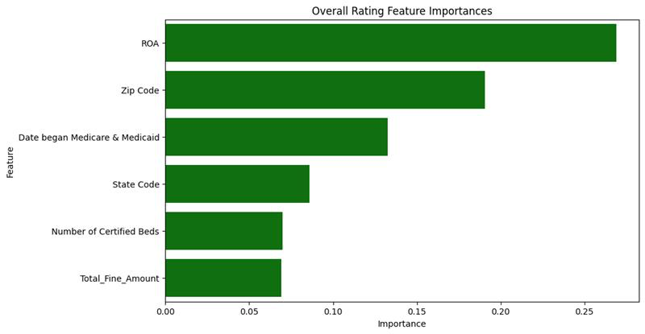
ROA Is the Best Predictor for Ratings
Using feature importances we found ROA to be the most important feature in predicting successful overall ratings
Stakeholders | Financial Performance | Operational Performance | Recommendation

Slide 12
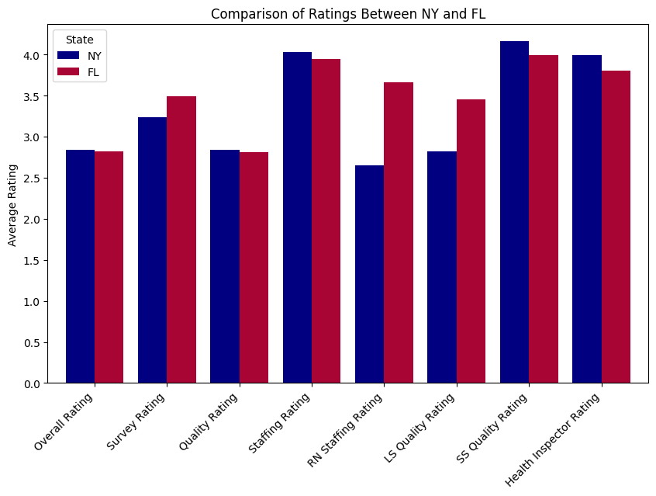
Is There a Difference in Ratings?
Stakeholders | Financial Performance | Operational Performance | Recommendation

Slide 13
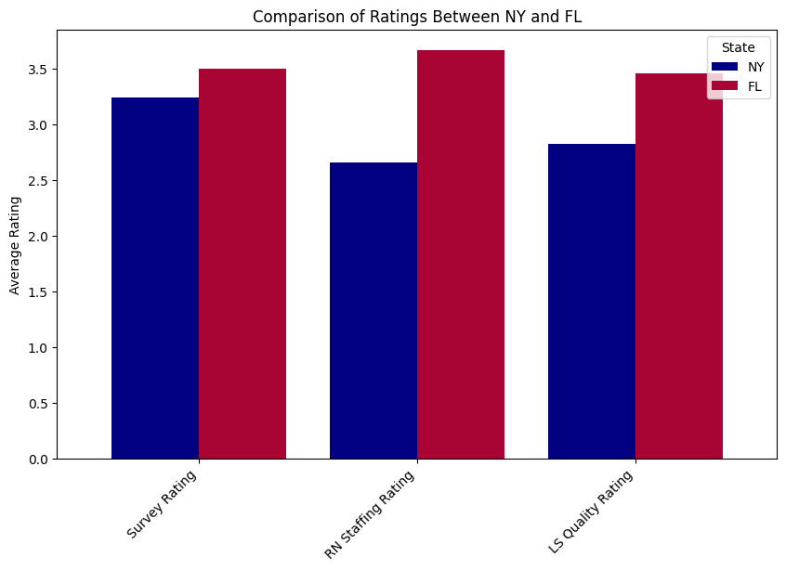
Florida Dominates New York on Certain Ratings
Stakeholders | Financial Performance | Operational Performance | Recommendation

Slide 14

Patient-Reported Survey Scores
Survey Rating
Patient reported survey score
Patient’s perspective on care facilities
Consistent before COVID-19 pandemic
Stakeholders | Financial Performance | Operational Performance | Recommendation

Slide 15

Caretaker’s Ratings for Nursing Facilities
Resident Nurse Rating
Ratings reported by resident nurses
Consistently rated throughout all years
Uniquely separated from general staff
Stakeholders | Financial Performance | Operational Performance | Recommendation

Slide 16

LS Quality Rating Focuses on the Most Impacted Group
Long-Stay Quality Ratings
Ratings by long-stay residents
Focuses on the most impacted group
Subset of overall resident quality score
Stakeholders | Financial Performance | Operational Performance | Recommendation

Slide 17
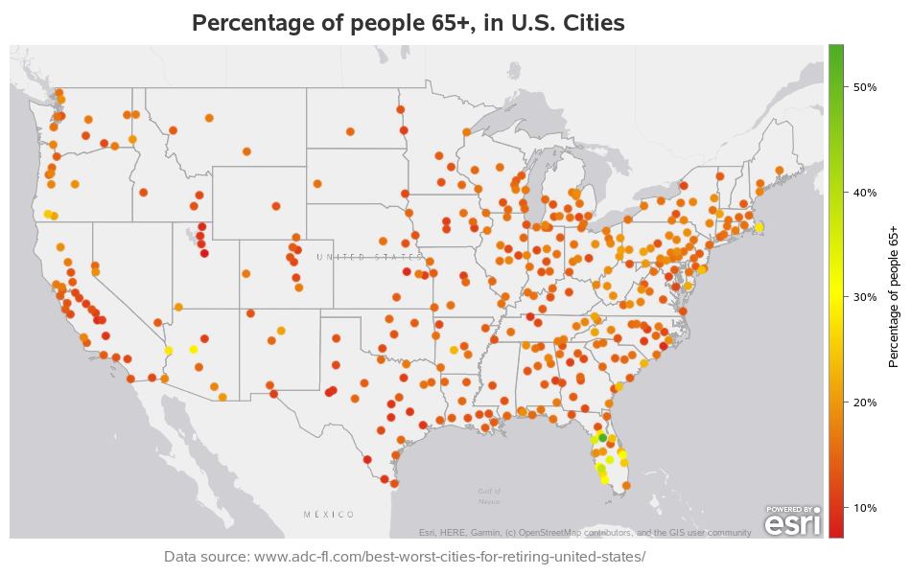
Which State Is the Best Investment?
We recommend Florida to both retirees and investors because of...
Focuses on people
Long-term investment potential
More investable nursing homes
Superior weather
Active lifestyle options
Tax benefits
Stakeholders | Financial Performance | Operational Performance | Recommendation
Notes:
Recommending FL:
People-focused business
Nursing homes are a long-term investment
Florida has year-round better weather
Drivable cities are better for senior citizens
Florida has a higher quantity of investable nursing homes than New York

Slide 18
Appendix
Average Age of Retirement
Overall Rating Breakdown: Health Inspector, Nurses, Quality Score
Overall Rating for NY vs FL
Florida's Tax Benefits
Average length of stay
State Response to COVID (heatmap)
Median Fine Amounts
Median Quality Score
Feature Importances from Ridge Model
Top 25 Zip Codes
11. Top 150 Above Average Zip Codes
12. Top 25 Average Net Incomes By State
13. Top 10 Averaged Important Features for Ridge
14. Top ROI With Above Average Facilities
15. Where is the best place to retire in the US?
16. Active Lifestyles in Florida
17. Poster From Phase 1

Slide 19
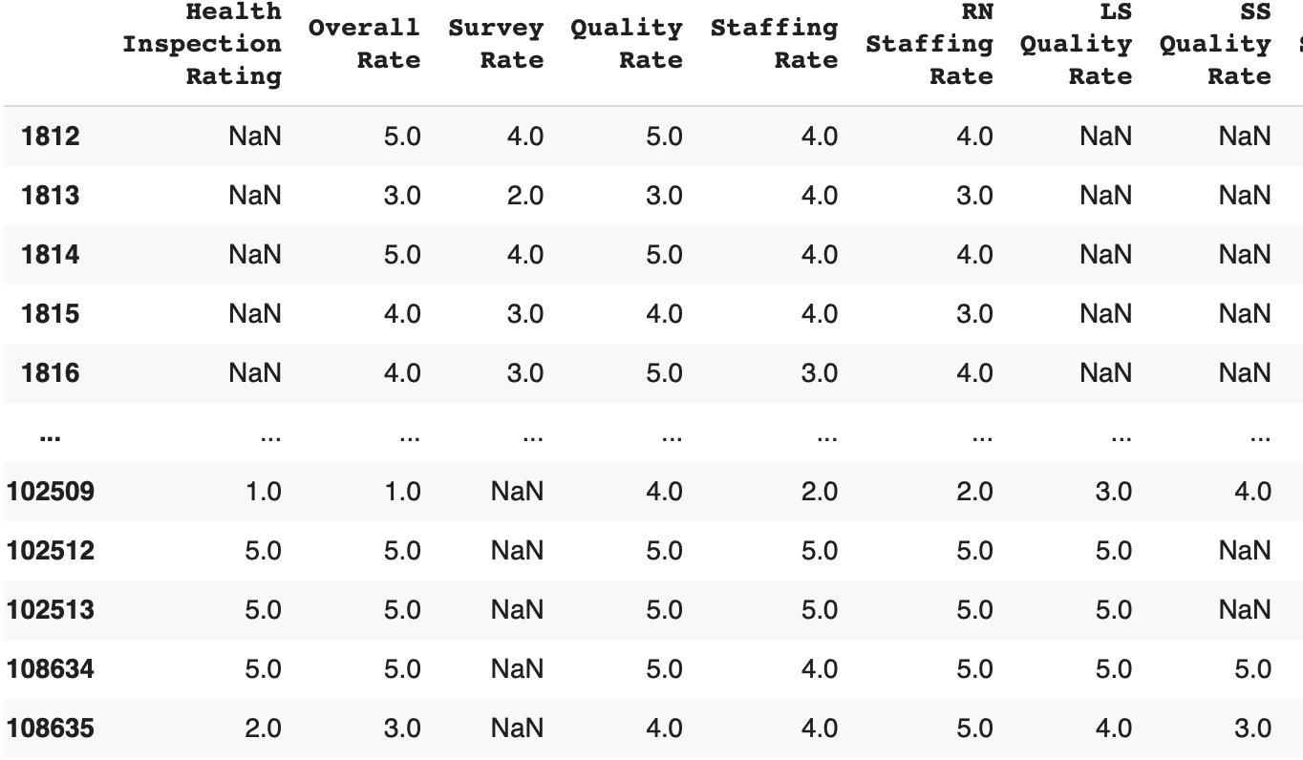
NaN Values in Overall Rating Lead Exploration
Why Choose Overall Rating?
Looking at NaN values lead us to inspect “LS Quality Rate,” “Survey Rate,” “RN Staffing Rate”
Where "SS" is short stay
Where "RN" is resident nurse
Why not Survey Rate?
Survey Rate as a column had minimal NaN values

Slide 20
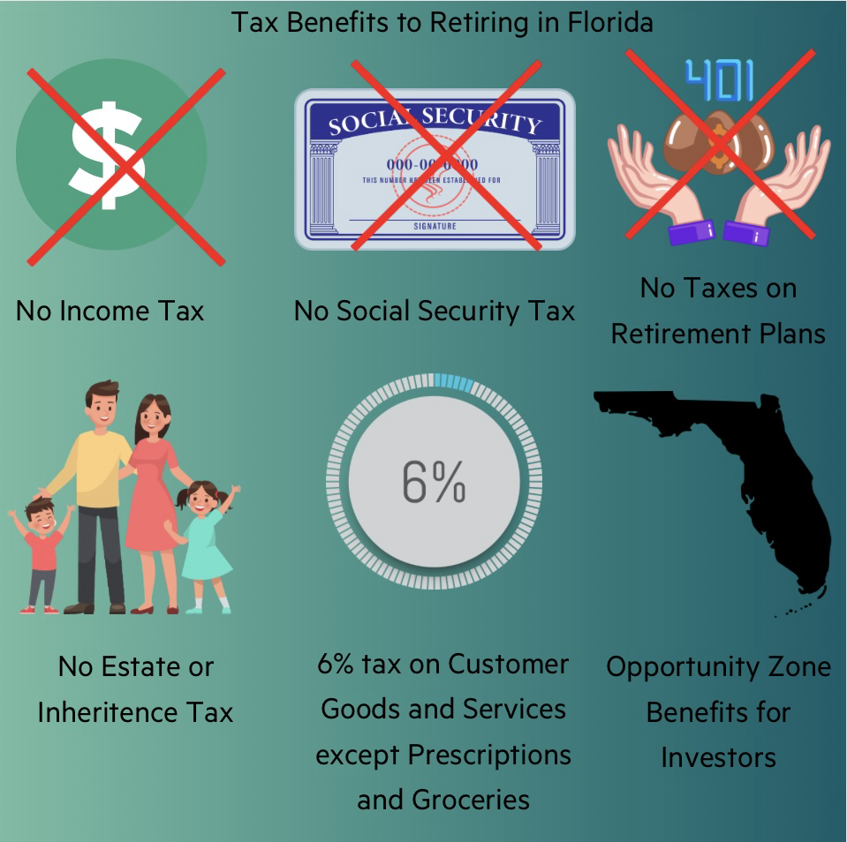
Florida's Tax Benefits
Source: Finance Buzz
Supported by: Acts Retirement

Slide 21
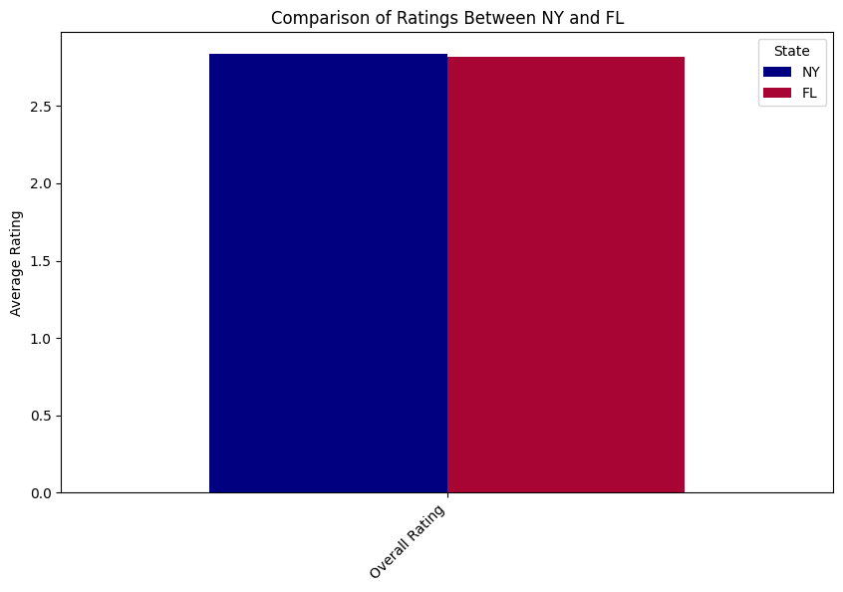
New York's Higher Overall Rating
New York has a slightly higher rating than Florida when comparing their overall rating
This overall rating compiles scores from survey rating, quality rating, staffing rating, registered nurse rating, long stay quality rating, short stay quality rating, and health inspector rating.

Slide 22

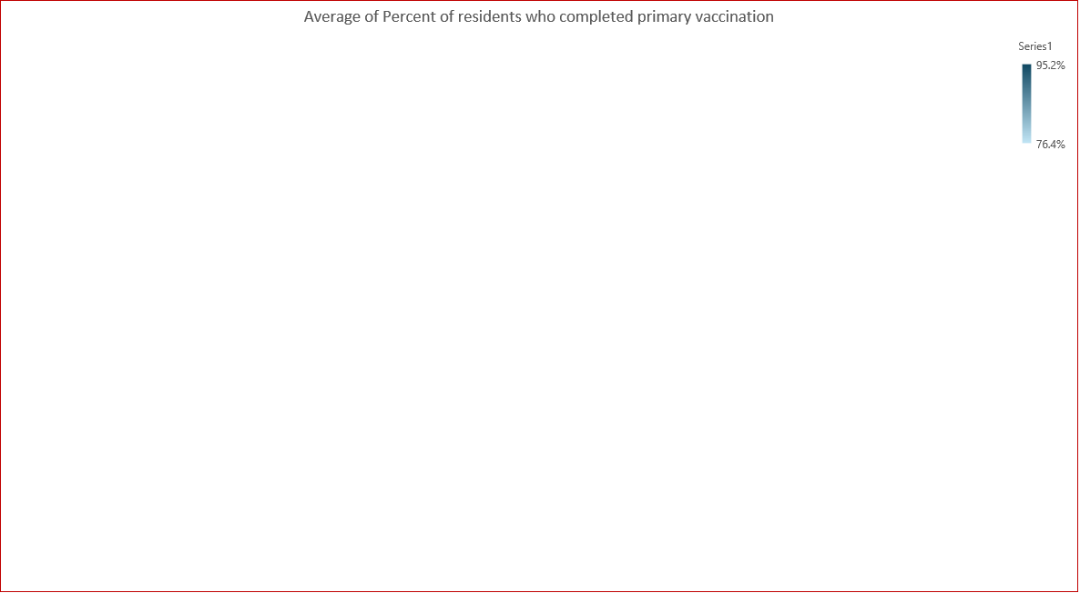
How Did States Responded to COVID-19?

Slide 23
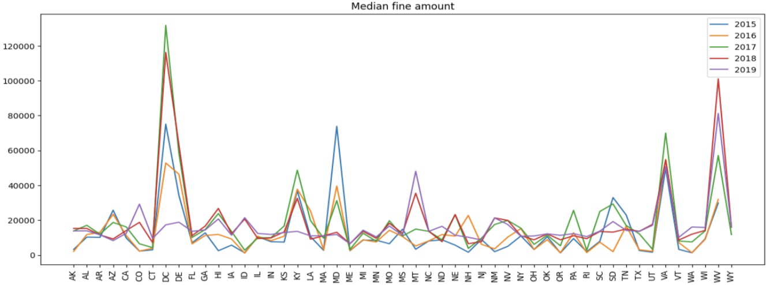
Median Fine Amounts Spike in the US

Slide 24
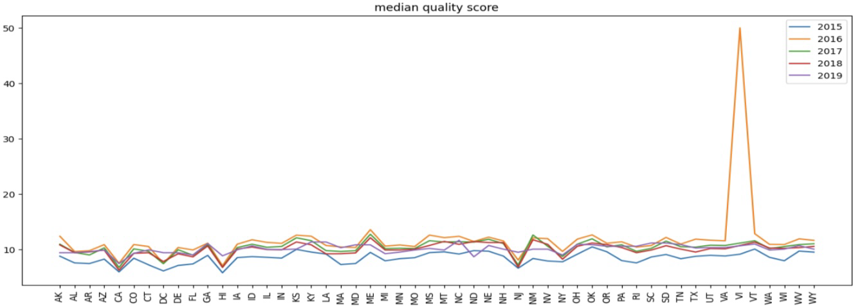
Median Quality Score Across the US

Slide 25
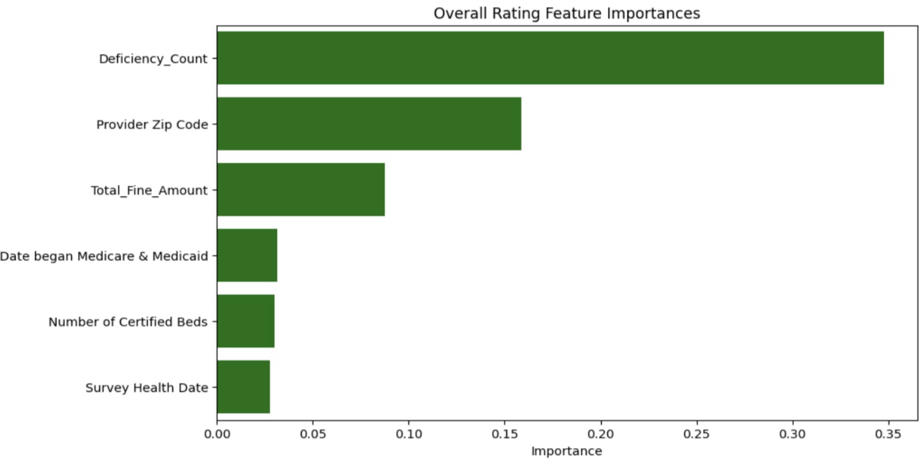
Feature Importances From Ridge Models

Slide 26
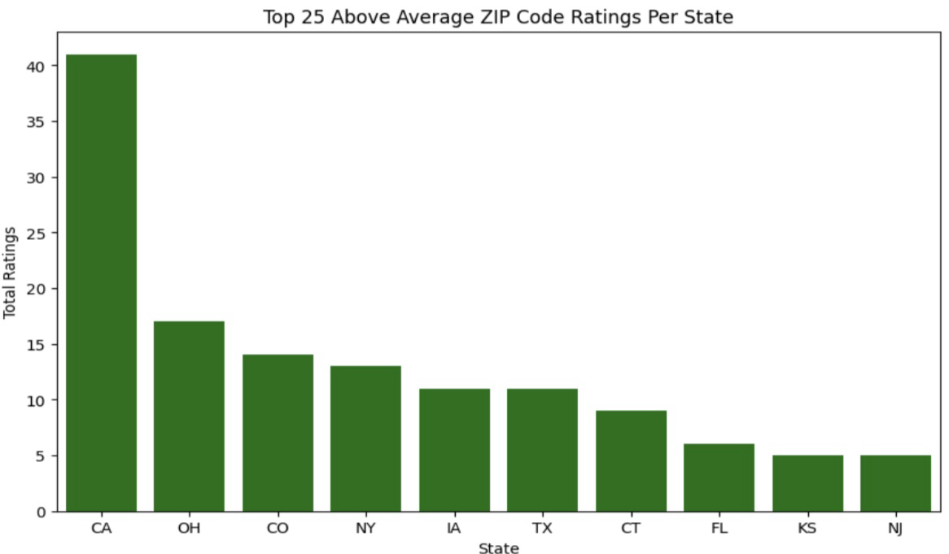
Top 25 Above Average Zip Code Ratings

Slide 27
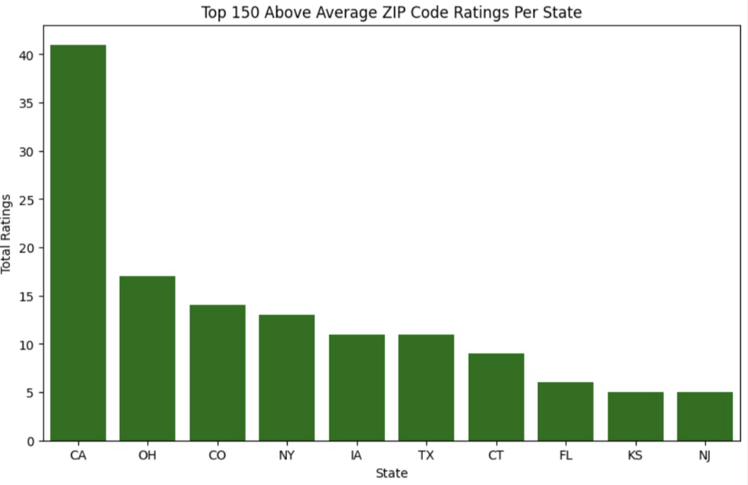
Top 150 Above Average Zip Code Ratings

Slide 28
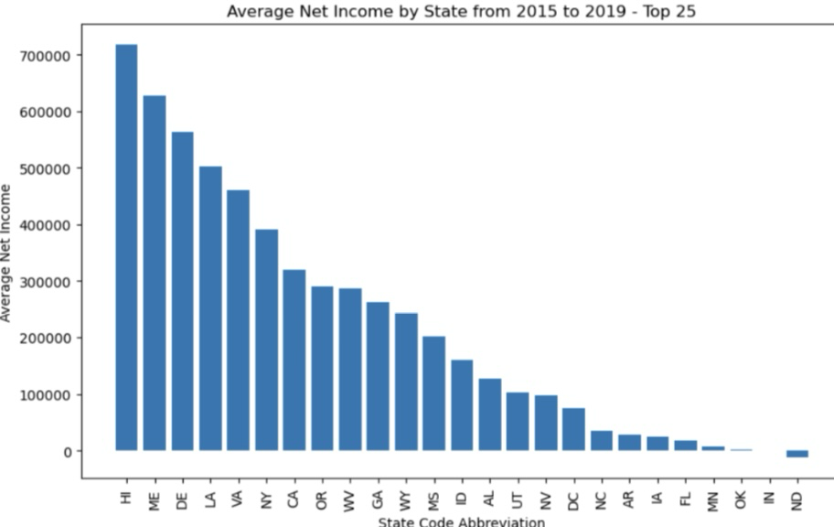
Top 25 Average Net Incomes by State

Slide 29
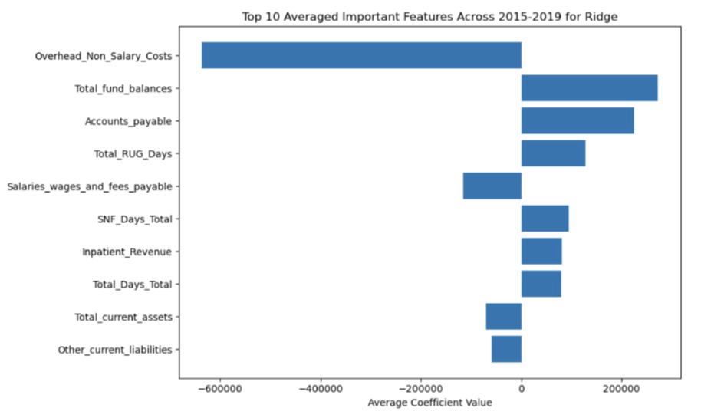
Top 10 Averaged Important Features for Ridge

Slide 30
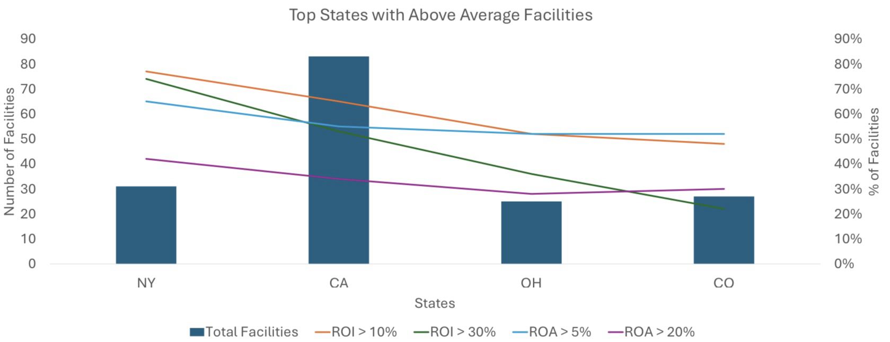
Top ROI With Above Average Facilities

Slide 31
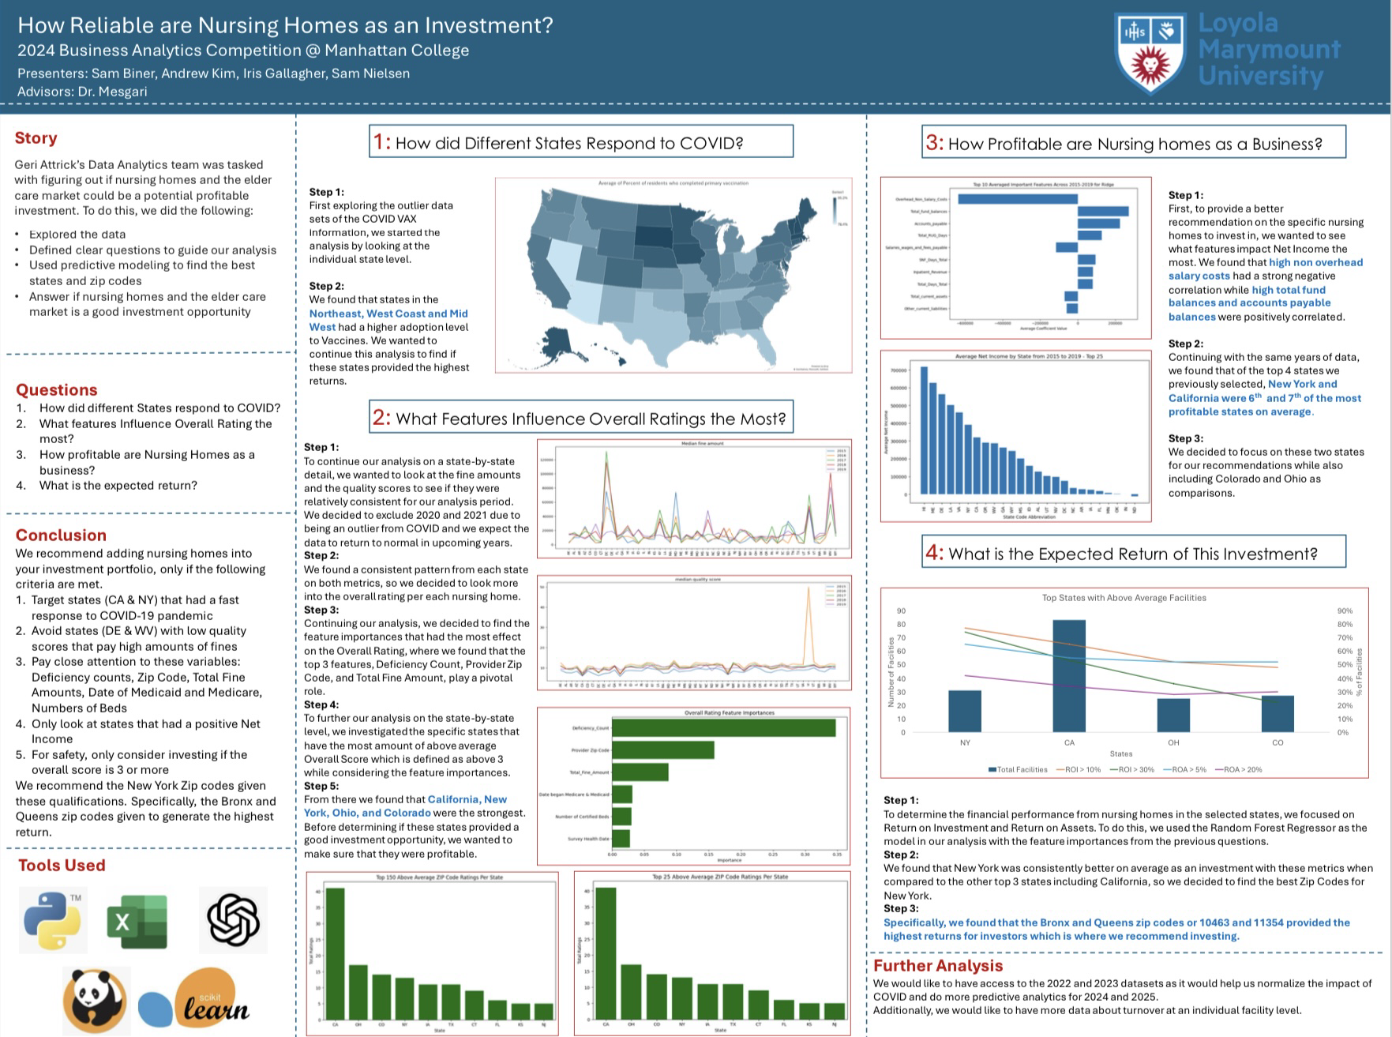
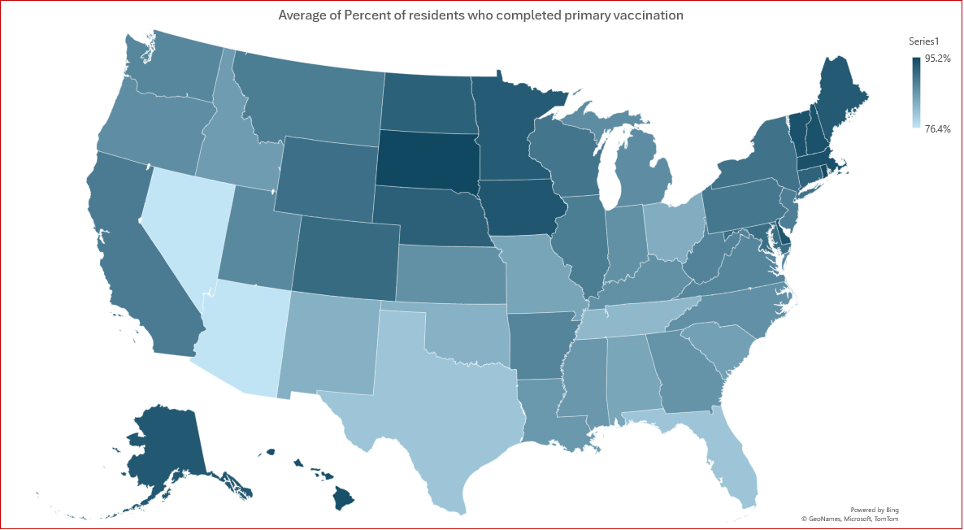
Nursing Homes Are a Good Financial Investment

Slide 32
Florida Senior Consulting Advisors Promote Exercise
Strength classes at home or in person at gyms
Strength Classes
Water aerobics
Zumba
Yoga
Tai Chi
Mobility
Source: Florida Senior Consulting

